Slide 1
Principal Component Analysis
(PCA)

Slide 2
Data Reduction
summarization of data with many (p) variables by a smaller set of (k) derived (synthetic, composite) variables.
p
k
A
X
n
n

Slide 3
Data Reduction
“Residual” variation is information in A that is not retained in X
balancing act between
  clarity of representation, ease of understanding
  oversimplification: loss of important or relevant information.

Slide 4
Principal Component Analysis
(PCA)
probably the most widely-used and well-known of the “standard” multivariate methods
invented by Pearson (1901) and Hotelling (1933)
first applied in ecology by Goodall (1954) under the name “factor analysis” (“principal factor analysis” is a synonym of PCA).

Slide 5
Principal Component Analysis
(PCA)
takes a data matrix of n objects by p variables, which may be correlated, and summarizes it by uncorrelated axes (principal components or principal axes) that are linear combinations of the original p variables
the first k components display as much as possible of the variation among objects.

Slide 6
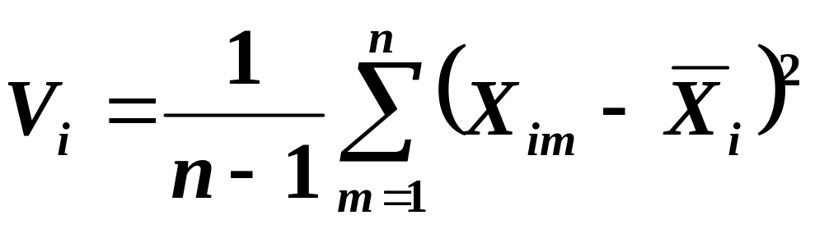
Geometric Rationale of PCA
objects are represented as a cloud of n points in a multidimensional space with an axis for each of the p variables
the centroid of the points is defined by the mean of each variable
the variance of each variable is the average squared deviation of its n values around the mean of that variable.

Slide 7
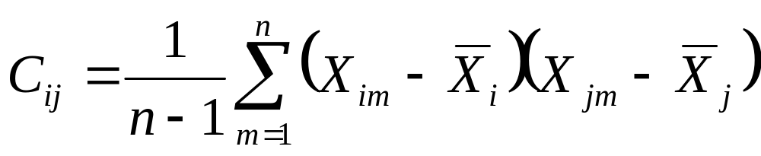
Geometric Rationale of PCA
degree to which the variables are linearly correlated is represented by their covariances.
Covariance of
variables i and j
Value of
variable i
in object m
Value of
variable j
in object m
Mean of
variable j
Mean of
variable i
Sum over all
n objects

Slide 8
Geometric Rationale of PCA
objective of PCA is to rigidly rotate the axes of this p-dimensional space to new positions (principal axes) that have the following properties:
  ordered such that principal axis 1 has the highest variance, axis 2 has the next highest variance, .... , and axis p has the lowest variance
  covariance among each pair of the principal axes is zero (the principal axes are uncorrelated).

Slide 9
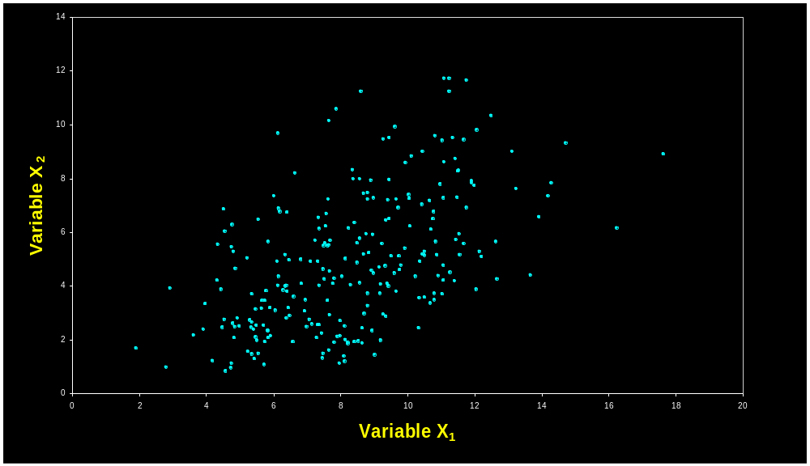
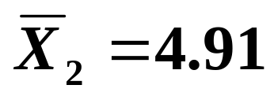
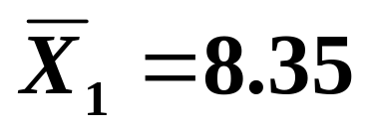
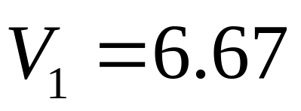
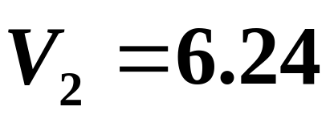
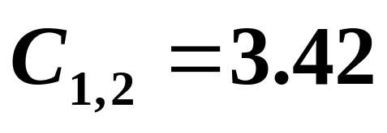
2D Example of PCA
variables X₁ and X₂ have positive covariance & each has a similar variance.

Slide 10
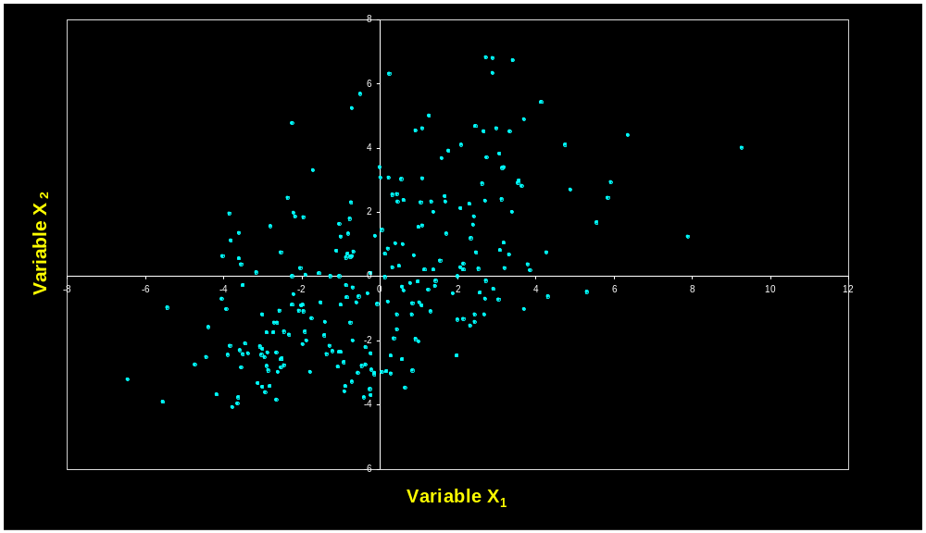
Configuration is Centered
each variable is adjusted to a mean of zero (by subtracting the mean from each value).

Slide 11
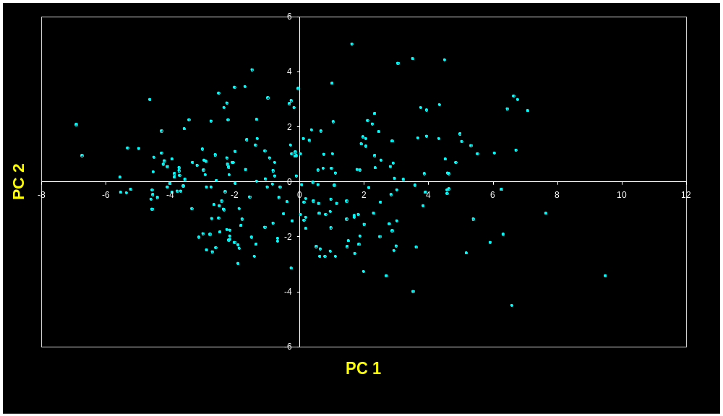
Principal Components are Computed
PC 1 has the highest possible variance (9.88)
PC 2 has a variance of 3.03
PC 1 and PC 2 have zero covariance.

Slide 12
The Dissimilarity Measure Used in PCA is Euclidean Distance
PCA uses Euclidean Distance calculated from the p variables as the measure of dissimilarity among the n objects
PCA derives the best possible k dimensional (k < p) representation of the Euclidean distances among objects.

Slide 13
Generalization to p-dimensions
In practice nobody uses PCA with only 2 variables
The algebra for finding principal axes readily generalizes to p variables
PC 1 is the direction of maximum variance in the p-dimensional cloud of points
PC 2 is in the direction of the next highest variance, subject to the constraint that it has zero covariance with PC 1.

Slide 14
Generalization to p-dimensions
PC 3 is in the direction of the next highest variance, subject to the constraint that it has zero covariance with both PC 1 and PC 2
and so on... up to PC p

Slide 15
each principal axis is a linear combination of the original two variables
PC_{j} = a_{i1}Y₁ + a_{i2}Y₂ + … a_{in}Y_{n}
a_{ij}’s are the coefficients for factor i, multiplied by the measured value for variable j
PC 1
PC 2

Slide 16
PC axes are a rigid rotation of the original variables
PC 1 is simultaneously the direction of maximum variance and a least-squares “line of best fit” (squared distances of points away from PC 1 are minimized).
PC 1
PC 2

Slide 17
Generalization to p-dimensions
if we take the first k principal components, they define the k-dimensional “hyperplane of best fit” to the point cloud
of the total variance of all p variables:
  PCs 1 to k represent the maximum possible proportion of that variance that can be displayed in k dimensions
  i.e. the squared Euclidean distances among points calculated from their coordinates on PCs 1 to k are the best possible representation of their squared Euclidean distances in the full p dimensions.

Slide 18
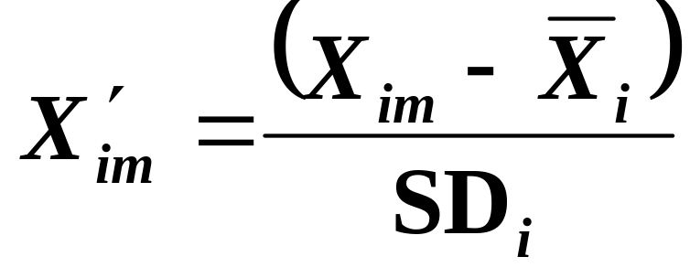
Covariance vs Correlation
using covariances among variables only makes sense if they are measured in the same units
even then, variables with high variances will dominate the principal components
these problems are generally avoided by standardizing each variable to unit variance and zero mean.
Mean
variable i
Standard deviation
of variable i

Slide 19
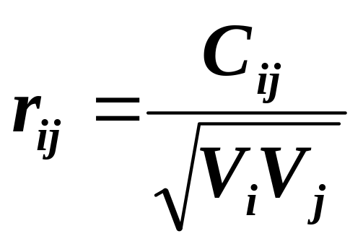
Covariance vs Correlation
covariances between the standardized variables are correlations
after standardization, each variable has a variance of 1.000
correlations can be also calculated from the variances and covariances:
Correlation between
variables i and j
Covariance of
variables i and j
Variance
of variable j
Variance
of variable i

Slide 20
The Algebra of PCA
first step is to calculate the cross-products matrix of variances and covariances (or correlations) among every pair of the p variables
square, symmetric matrix
diagonals are the variances, off-diagonals are the covariances.
 | X₁ | X₂
X₁ | 6.6707 | 3.4170
X₂ | 3.4170 | 6.2384
 | X₁ | X₂
X₁ | 1.0000 | 0.5297
X₂ | 0.5297 | 1.0000
Variance-covariance Matrix
Correlation Matrix

Slide 21
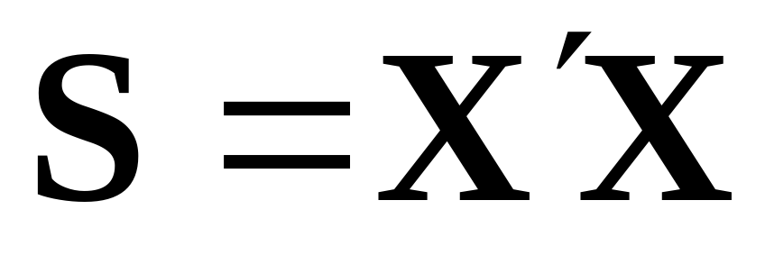
The Algebra of PCA
in matrix notation, this is computed as
where X is the n x p data matrix, with each variable centered (also standardized by SD if using correlations).
 | X₁ | X₂
X₁ | 6.6707 | 3.4170
X₂ | 3.4170 | 6.2384
 | X₁ | X₂
X₁ | 1.0000 | 0.5297
X₂ | 0.5297 | 1.0000
Variance-covariance Matrix
Correlation Matrix

Slide 22
Manipulating Matrices
transposing: could change the columns to rows or the rows to columns
multiplying matrices
  must have the same number of columns in the premultiplicand matrix as the number of rows in the postmultiplicand matrix
X = 10 0 4
7 1 2
X’ = 10 7
0 1
4 2

Slide 23
The Algebra of PCA
sum of the diagonals of the variance-covariance matrix is called the trace
it represents the total variance in the data
it is the mean squared Euclidean distance between each object and the centroid in p-dimensional space.
 | X₁ | X₂
X₁ | 6.6707 | 3.4170
X₂ | 3.4170 | 6.2384
 | X₁ | X₂
X₁ | 1.0000 | 0.5297
X₂ | 0.5297 | 1.0000
Trace = 12.9091
Trace = 2.0000

Slide 24
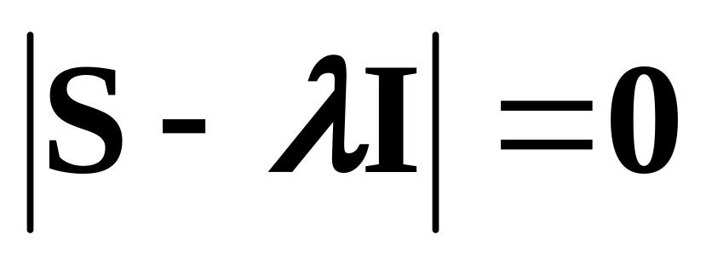
The Algebra of PCA
finding the principal axes involves eigenanalysis of the cross-products matrix (S)
the eigenvalues (latent roots) of S are solutions (λ) to the characteristic equation

Slide 25
The Algebra of PCA
the eigenvalues, λ₁, λ₂, ... λ_{p} are the variances of the coordinates on each principal component axis
the sum of all p eigenvalues equals the trace of S (the sum of the variances of the original variables).
 | X₁ | X₂
X₁ | 6.6707 | 3.4170
X₂ | 3.4170 | 6.2384
λ₁ = 9.8783
λ₂ = 3.0308
Note: λ₁+λ₂ =12.9091
Trace = 12.9091

Slide 26
The Algebra of PCA
each eigenvector consists of p values which represent the “contribution” of each variable to the principal component axis
eigenvectors are uncorrelated (orthogonal)
  their cross-products are zero.
Eigenvectors
 | u₁ | u₂
X₁ | 0.7291 | -0.6844
X₂ | 0.6844 | 0.7291
0.7291*(-0.6844) + 0.6844*0.7291 = 0

Slide 27
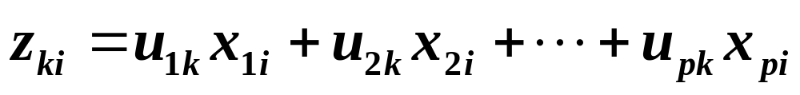
The Algebra of PCA
coordinates of each object i on the k^{th} principal axis, known as the scores on PC k, are computed as
where Z is the n x k matrix of PC scores, X is the n x p centered data matrix and U is the p x k matrix of eigenvectors.

Slide 28
The Algebra of PCA
variance of the scores on each PC axis is equal to the corresponding eigenvalue for that axis
the eigenvalue represents the variance displayed (“explained” or “extracted”) by the k^{th} axis
the sum of the first k eigenvalues is the variance explained by the k-dimensional ordination.

Slide 29
λ₁ = 9.8783 λ₂ = 3.0308 Trace = 12.9091
PC 1 displays (“explains”)
9.8783/12.9091 = 76.5% of the total variance

Slide 30
The Algebra of PCA
The cross-products matrix computed among the p principal axes has a simple form:
  all off-diagonal values are zero (the principal axes are uncorrelated)
  the diagonal values are the eigenvalues.
 | PC₁ | PC₂
PC₁ | 9.8783 | 0.0000
PC₂ | 0.0000 | 3.0308
Variance-covariance Matrix
of the PC axes

Slide 31
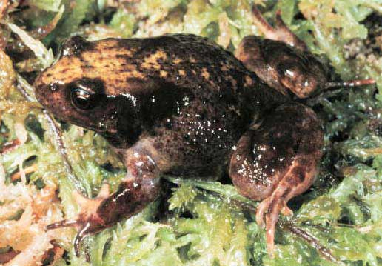
A more challenging example
data from research on habitat definition in the endangered Baw Baw frog
16 environmental and structural variables measured at each of 124 sites
correlation matrix used because variables have different units
Philoria frosti

Slide 32
Eigenvalues
Axis | Eigenvalue | % of Variance | Cumulative % of Variance
1 | 5.855 | 36.60 | 36.60
2 | 3.420 | 21.38 | 57.97
3 | 1.122 | 7.01 | 64.98
4 | 1.116 | 6.97 | 71.95
5 | 0.982 | 6.14 | 78.09
6 | 0.725 | 4.53 | 82.62
7 | 0.563 | 3.52 | 86.14
8 | 0.529 | 3.31 | 89.45
9 | 0.476 | 2.98 | 92.42
10 | 0.375 | 2.35 | 94.77

Slide 33
Interpreting Eigenvectors
 | 1 | 2 | 3
Altitude | 0.3842 | 0.0659 | -0.1177
pH | -0.1159 | 0.1696 | -0.5578
Cond | -0.2729 | -0.1200 | 0.3636
TempSurf | 0.0538 | -0.2800 | 0.2621
Relief | -0.0765 | 0.3855 | -0.1462
maxERht | 0.0248 | 0.4879 | 0.2426
avERht | 0.0599 | 0.4568 | 0.2497
%ER | 0.0789 | 0.4223 | 0.2278
%VEG | 0.3305 | -0.2087 | -0.0276
%LIT | -0.3053 | 0.1226 | 0.1145
%LOG | -0.3144 | 0.0402 | -0.1067
%W | -0.0886 | -0.0654 | -0.1171
H1Moss | 0.1364 | -0.1262 | 0.4761
DistSWH | -0.3787 | 0.0101 | 0.0042
DistSW | -0.3494 | -0.1283 | 0.1166
DistMF | 0.3899 | 0.0586 | -0.0175
correlations between variables and the principal axes are known as loadings
each element of the eigenvectors represents the contribution of a given variable to a component

Slide 34
How many axes are needed?
does the (k+1)^{th} principal axis represent more variance than would be expected by chance?
several tests and rules have been proposed
a common “rule of thumb” when PCA is based on correlations is that axes with eigenvalues > 1 are worth interpreting

Slide 35
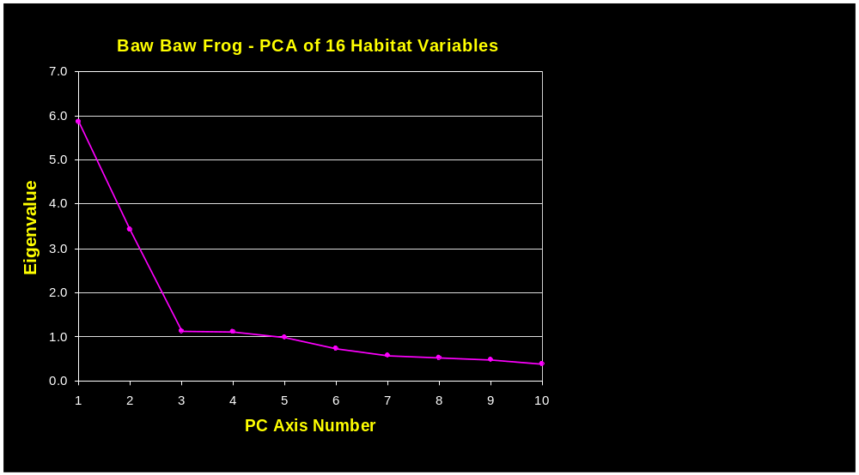

Slide 36
What are the assumptions of PCA?
assumes relationships among variables are LINEAR
  cloud of points in p-dimensional space has linear dimensions that can be effectively summarized by the principal axes
if the structure in the data is NONLINEAR (the cloud of points twists and curves its way through p-dimensional space), the principal axes will not be an efficient and informative summary of the data.

Slide 37
When should PCA be used?
In community ecology, PCA is useful for summarizing variables whose relationships are approximately linear or at least monotonic
  e.g. A PCA of many soil properties might be used to extract a few components that summarize main dimensions of soil variation
PCA is generally NOT useful for ordinating community data
Why? Because relationships among species are highly nonlinear.

Slide 38
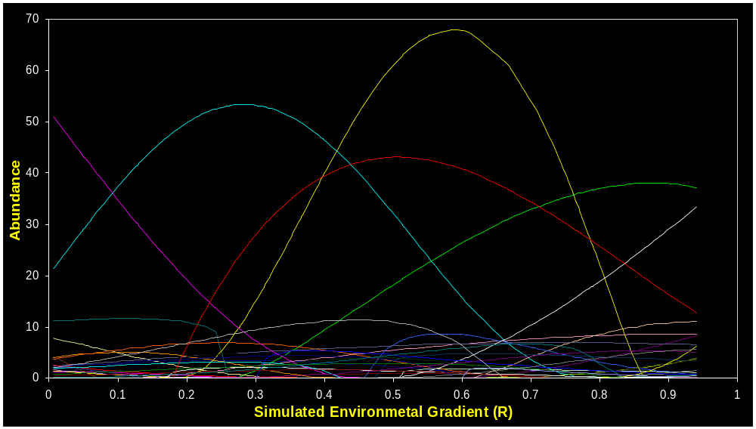

Slide 39
The “Horseshoe” or Arch Effect
community trends along environmenal gradients appear as “horseshoes” in PCA ordinations
none of the PC axes effectively summarizes the trend in species composition along the gradient
SUs at opposite extremes of the gradient appear relatively close together.

Slide 40
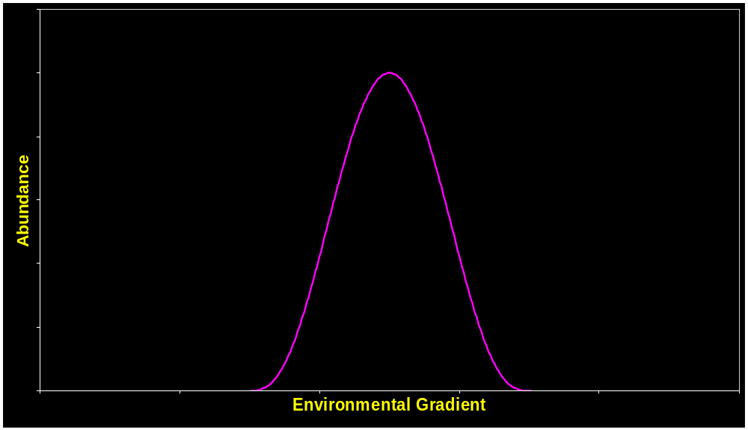
Ambiguity of Absence
0

Slide 41
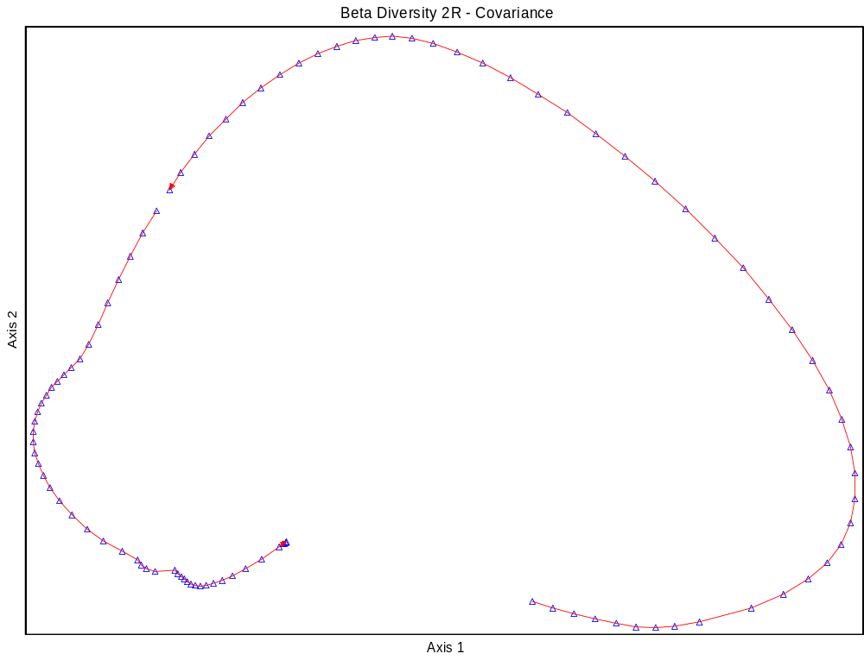

Slide 42
The “Horseshoe”Effect
curvature of the gradient and the degree of infolding of the extremes increase with beta diversity
PCA ordinations are not useful summaries of community data except when beta diversity is very low
using correlation generally does better than covariance
  this is because standardization by species improves the correlation between Euclidean distance and environmental distance.

Slide 43
What if there’s more than one underlying ecological gradient?

Slide 44
The “Horseshoe” Effect
when two or more underlying gradients with high beta diversity a “horseshoe” is usually not detectable
the SUs fall on a curved hypersurface that twists and turns through the p-dimensional species space
interpretation problems are more severe
PCA should NOT be used with community data (except maybe when beta diversity is very low).

Slide 45
Impact on Ordination History
by 1970 PCA was the ordination method of choice for community data
simulation studies by Swan (1970) & Austin & Noy-Meir (1971) demonstrated the horseshoe effect and showed that the linear assumption of PCA was not compatible with the nonlinear structure of community data
stimulated the quest for more appropriate ordination methods.

